Slide 1
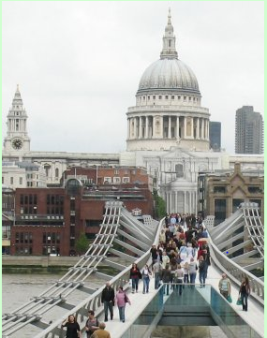
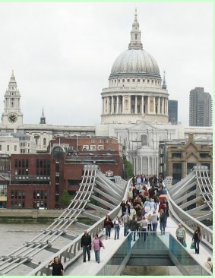
YOYO 1. Spot the differences 2. Turn In Timeline/sitn #2

Slide 2
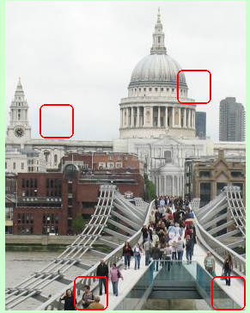
YOYO – Spot the differences

Slide 3
Aim: Who’s who at a crime scene?
Scanlon/Mammolito

Slide 4
Who’s Who at a crime scene: Jig Saw Activity
Round 1: Meet with other people who are assigned to become the “expert” for the same topic
Police Officer
CSI Unit
District Attorney
Medical Examiner
Specialist
Detective

Slide 5
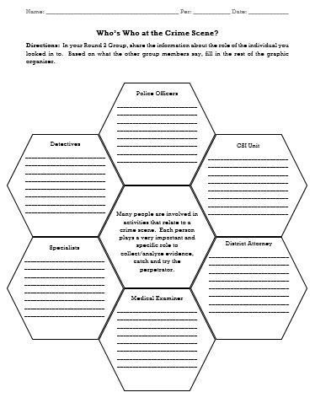
Who’s Who at a crime scene: Jig Saw Activity
Round 2: Meet with one “expert” for each topic. Each student will be an expert on something and will explain their topic to the group. If not explaining, you are listening and filling in the graphic organizer.
1 Police officer, 1 CSI Unit Official, 1 DA, 1 ME, 1 specialist, 1 Detective.

Slide 6
Before You Leave - Exit Ticket:
Reading the following scenarios, determine person who completes the job based on the information in your graphic organizer.
Contacts a judge to receive a warrant to search a suspects house. DISTRICT ATTORNEY
Typically the first to arrive at the crime scene, and is responsible for securing the scene. POLICE OFFICER
May be called in specifically to identify a victim by analyzing the dental record. SPECIALIST/FORENSIC ANTHROPOLOGIST
Collects evidences and documents the crime scene. CSI UNIT
Conducts interviews with eyewitness, suspects, and follows leads based on evidence collected. DETECTIVE
Determines the cause of death of the victim. MEDICAL EXAMINER

