Slide 1
Yoyo:
QUESTION:
A man was found dead with a cassette recorder in one hand and a gun in the other. When the police came in, they immediately pressed the play button on the cassette. He said "I have nothing else to live for. I can't go on," then the sound of a gunshot. After listening to the cassette tape, the police knew that it was not a suicide, but a homicide. How did they know?

Slide 2
Yoyo:
QUESTION:
A man was found dead with a cassette recorder in one hand and a gun in the other. When the police came in, they immediately pressed the play button on the cassette. He said "I have nothing else to live for. I can't go on," then the sound of a gunshot. After listening to the cassette tape, the police knew that it was not a suicide, but a homicide. How did they know?
ANSWER:
If the man shot himself while he was recording, how did he rewind the cassette tape?

Slide 3
AIM: What are the Steps in pursing justice?
Scanlon/Mammolito

Slide 4
General time Line
Arrest warrant issued
A crime is committed
Info/evidence collected
Suspect Identified
Establish probable cause

Slide 5
If You Are The “bad guy” watch out!
Your Rights
Did the arresting officer read you your Miranda rights?
You have the right to remain silent. Anything you say can and will be held against you in the court of law. You have the right to an attorney. If you cannot afford an attorney one will be provided for you. Do you understand the rights I have just read to you?

Slide 6
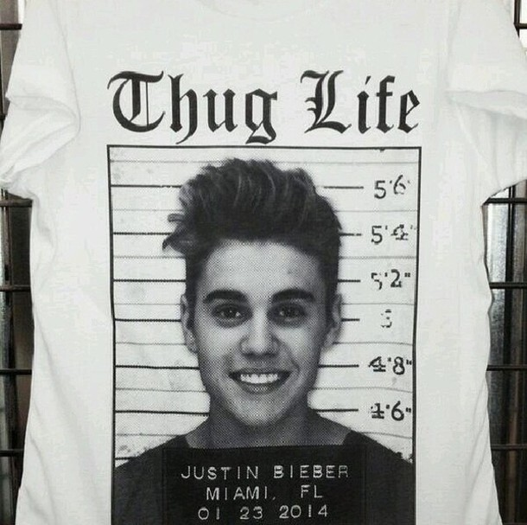
If You Are The “bad guy” watch out!
Booking
Basic info, photo, fingerprints
Arraignment
Being brought before a judge within 72 hours

Slide 7
If You Are The “bad guy” watch out!
Pleas
Guilty
Not Guilty
Not Guilty by insanity
Nolo contendre (no contest)
Only in criminal cases – does not deny facts, but does not admit any crime – accepts punishment

Slide 8
How do you plea?
Guilty
Not Guilty
Not Guilty because of insanity
Preliminary hearing No jury Prosecution presents Defense can too Judge passes sentence | Preliminary hearing No jury Judge decides if there is enough evidence to stand trial If so, gets trial date Determines bail | Very specific procedures Defendant has to prove convincing evidence that at the time of the offense they were unable to appreciate the nature of the crime

Slide 9
Remember
You are innocent until proved guilty
It is up to the prosecution to find substantial proof!

Slide 10
The Grand jury
Use instead of a preliminary hearing
Often in the case of a felony
Consists of 16-23 citizens
They will determine if there is enough to go to trial
Only the prosecutor presents
No cross-examination allowed
Decided by majority vote
If 16 citizens make up the grand jury, the majority vote is 9 votes
If 23 citizens make up the grand jury, the majority vote is 12 votes
Indictment – if the accused is formally charged – a trial date will be set

Slide 11
What is evidence…specifically?
Must be relevant
Must prove something (probative)
Must address the issue of the crime (material)
Person who presents must be competent and believable
Hearsay – not admissible in court – only civil
It is not considered reliable since it Is not taken under oath, nor subject to cross-examination

Slide 12
Court Cases to Determine How Court Should Run
Frye v. United States
Commonly known as the “general acceptance” test
Scientific evidence is admissible at trail only if the scientific principle law sufficiently gain acceptance in the scientific community
After presentation by the expert witness, the jury decides of the evidence has any significance
Applies only to “new” or “novel” methodologies

Slide 13
What we have done so far
Fact vs. Opinion Reading
The Importance of Observation
Eyewitness Basics – Procs and Cons of Testimonial Evidence
A Brief History of Forensics
Who’s Who at the Crime Scene
Types of Crime
IF YOU ARE MISSING ANY OF THIS…IT IS ON THE WEBSITE or ASK ME and I may have extra paper copies

