Slide 1
YOYO
Turn in SITN #4 in the folder up front.
You are sitting at your desk. What are you in contact with? What possible transfer of material could have taken or is taking place? MAKE A LIST! How could you have prevented any transfer if you had thought about it first? What transferred material could be traced to you directly?
Think about when you came to school today. Did you leave any evidence that you were here other than being observed by others (eyewitness accounts)?

Slide 2
Aim: What are the different types of PHYSICAL EVIDENCE?
Scanlon/Mammolito

Slide 3
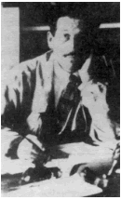
Locard’s Exchange Principle
“EVERY CONTACT LEAVES A TRACE”
The value of trace (or contact) forensic evidence was first recognized by Edmund Locard in 1910. He was the director of the very first crime laboratory in existence, located in Lyon, France.

Slide 4
Locard’s Exchange Principle
The Locard’s Exchange Principle states that "with contact between two items, there will be an exchange." For example, burglars will leave traces of their presence behind and will also take traces with them. They may leave hairs from their body or fibers from their clothing behind and they may take carpet fibers away with them.

Slide 5
Individual vs. Class Evidence
Individual Evidence
Material that can be related to a single source; individualization always involves a comparison
Class Evidence
Material that can be associated only with a group of items that share properties or characteristics

Slide 6
Evidence Examples: PAINT
Physical and chemical analysis of paint evidence (chips or residue) can indicate it’s class, such as automobile paint, house paint, nail polish, etc. The evidence can be compared to 40,000 different types of paint classified in a database, which can be used to identify a particular make or model of car or brand of tool.

Slide 7
Evidence Examples: PAINT
Paint evidence can also indicate individual characteristics if an investigator is able to find similarities between two samples, such as the color, number of layers, chemical composition, or a physical match between the edges of two paint chips – one from a tool and one from a crime scene.

Slide 8
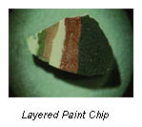
Evidence Examples: PAINT
DID YOU KNOW: Most paint evidence submitted to a lab will come form hit-and-run cases involving automobiles.
Paint Transfer on a Car
Paint Layers
Physical Match of Paint Chip Edges

Slide 9
Evidence Examples: Glass
Glass particles can be found at various crime scenes, such as breaking and entering, hit and run, vandalism, or murder.
Glass at a crime scene is analyzed to determine its color, surface characteristics, tint, thickness, density, chemical composition, and refractive index (RI).
The results of the tests provide clues about the crime and help investigators connect the evidence to a suspect or other object used in a crime, such as matching glass from a crime scene to a headlight to a suspect’s car.

Slide 10
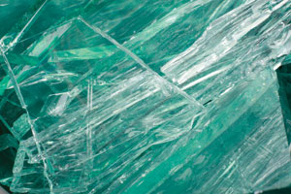
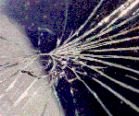
Evidence Examples: Glass
Magnified image of glass fragments
The pattern of cracks in a windshield fracture can reveal information about speed, occupant position, and angle of impact.

Slide 11
Evidence Examples: Explosives
Explosive substances can be examined to determine its chemical composition to identify the type of explosive used and its origin.
Traces of explosives found on a suspect’s clothing, skin, hair, or other objects may be matched to explosives from the crime scene.
Materials used to make an explosive device will be compared to evidence found in the suspect’s possession to confirm a match.

Slide 12
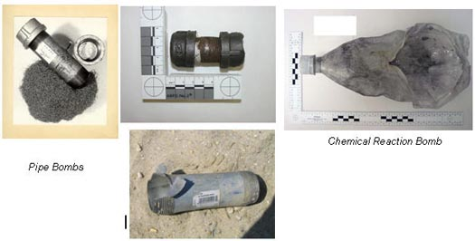
Evidence Examples: Explosives

Slide 13
Evidence Examples: Ballistics
Characteristics of ammunition, firearms, and residue are examined to find matches between suspects and the evidence found at a crime scene.
Chemical tests can reveal gunshot residue (GSR) on the hands, face, or clothing of a victim or suspect to indicate how close a person was to a fired gun.
DID YOU KNOW: Caliber (handguns & rifles) or guage (shotguns) refers to the size of the internal diameter of a gun’s barrel.

Slide 14
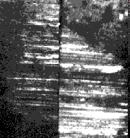
Evidence Examples: Ballistics
Rifling (grooves) in a gun barrel causes distinctive grooves, indentations and scratches upon fired bullets, which can be matched to the weapon that fired them.
Police are able to search the Integrated Ballistics Identification System (IBIS) database to compare markings from bullets, cartridge cases, and shotgun shells to ballistic evidence.
Investigators can compare the striations on bullets to see if they match.

Slide 15
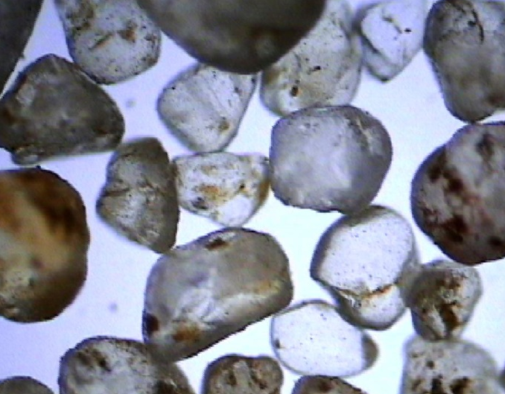
Evidence Examples: Dust and Dirt
Dust, dirt, or sand evidence can reveal where a person has traveled and may be picked up at a crime scene or left behind.
Investigators examine the samples for chemical composition, pollen, plant material, and other organic matter to find links to a specific crime scene.
Microscopic Image of Sand

Slide 16
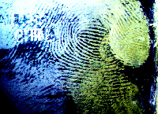
Evidence Examples: Fingerprints
There are 3 types of fingerprint patterns: arches, loops, and whorls. Investigators also identify unique ridge characteristics in a fingerprint that can be used to identify a suspect or victim.
AFIS (Automated Fingerprint Identification System) is a database used by investigators at local, state, and national levels to search for matches to fingerprints found at a crime scene.

Slide 17
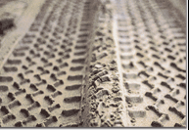
Evidence Examples: Impression Evidence – Shoeprints & Tire Tracks
Impression evidence can be photographed, lifted with tape, or cast with plaster to compare to a suspect’s shoes or tires.
Investigators will examine the evidence to identify the brand of shoe or tire based on its tread pattern and other physical features to provide leads in the case.

Slide 18
Evidence Examples: Impression Evidence – Shoeprints & Tire Tracks
Shoes and tires will also show wear patterns after being used for a period of time as well as other features (scratches, nicks, and cuts) that can be used to match evidence to specific items. For example, shoeprints can be matched to a suspect based on how the treads on the shoes that are worn down due to that person’s walking style.

Slide 19
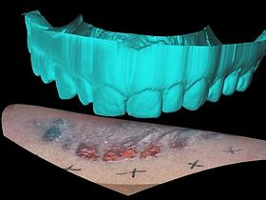
Evidence Examples: Impression Evidence – Bite Marks
Each of the 32 teeth in humans is unique due to age and wear.
Impressions and photographs of bite marks left on a victim, assailant, or other object at a crime scene can often be matched to dental records.

Slide 20
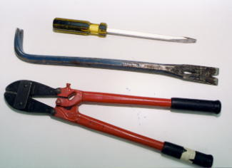
Evidence Examples: Impression Evidence – Tool Marks
Tiny nicks and chips form on the edges of a tool as it is used, which can be used to identify matches between evidence and suspects.
Tools may also pick up traces of blood or other substances that can be tested or have fingerprints that can be lifted.

Slide 21
Evidence Examples: Fracture Matches
When an object broken, torn, or cut, two unique edges are formed, which are referred to as fracture lines.
These edges can be compared by the naked eye or with microscopes to see if they fit together , which indicates that they may have been part of the same object at one time.
Investigators may compare the edges on pieces of tape, glass fragments, paint chips, pieces of a car from an accident, paper bag, etc. to find possible matches.

Slide 22
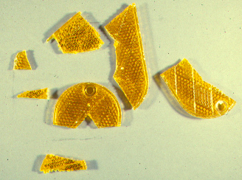
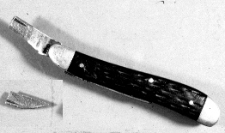
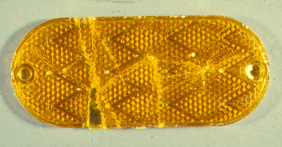
Evidence Examples: Fracture Matches

Slide 23
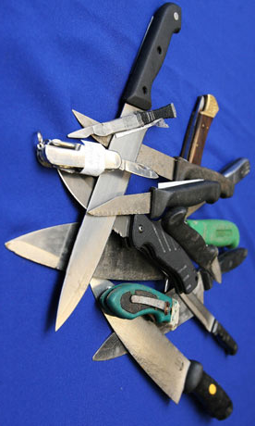
Evidence Examples: Wounds
Wounds can often be matched to weapons or tool marks on the weapon. Investigators may also be able to determine the weapon's size, shape, and length.
Analysis of a wound may provides clues to a victim’s injuries, characteristics of the suspect (left-handed, right-handed, height, etc.), and positions of the victim and suspect at the time of the incident.

Slide 24
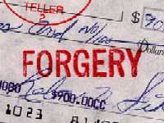
Evidence Examples: Questioned Documents
Examiners will analyze a ransom note or other document to find clues to link it to a crime scene or a specific suspect. They will analyze the type of paper used, printing method or handwriting style, and type of ink.
Other unique features, such as watermarks on stationary or indentations made as someone wrote on a page in a notebook, may provide useful clues.

Slide 25
Evidence Examples: Insects
Flies, beetles, and other insects can provide useful clues about a corpse.
Forensic entomologists use factors such as weather conditions, the location and condition of the body, and their knowledge of the life cycles of insects to help them estimate the postmortem interval or PMI (the time between death and the discovery of the body).

Slide 26
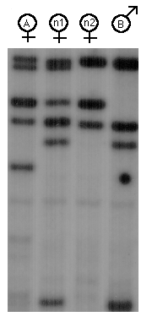
Evidence Examples: DNA
Investigators can extract DNA from almost any tissue, including hair, fingernails, bones, teeth and body fluids. The DNA is used to create a profile that can be compared to profiles from suspects or victims.
CODIS (Combined DNA Index System) is a database maintained by the FBI that is used to find matches to unknown DNA samples from a crime scene.

Slide 27
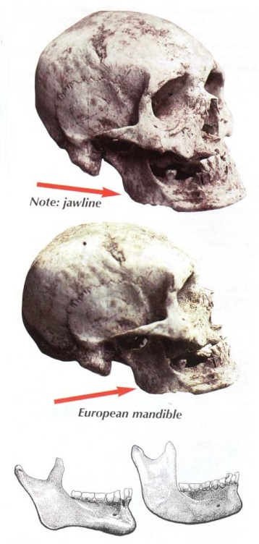
Evidence Examples: Skeletal Remains
Forensic anthropologists analyze skeletal remains to determine four characteristics for a victim: age, sex, race, and stature (height/build).
Sex - Determined by examining the pelvis, humerus, and femur
Age and stature – Determined by analyzing the development of the teeth, bone growth, and the length of specific bones, such as the femur.
Race – Determined by analyzing the skull for characteristics that are common among people of different races.

Slide 28
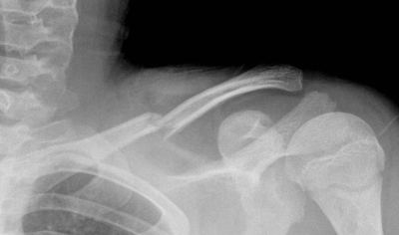
Evidence Examples: Skeletal Remains
DNA samples can be collected from bone, teeth, and hair to provide clues to a person’s identity. Scientists may also be able to gain clues as to a person’s past, recent injuries, or the cause of death based on bone fractures and other signs of trauma.

Slide 29
What do forensic anthropologists do?
Generally, forensic anthropologists DO NOT do any of the following:
Collect trace evidence (hair, fibers)
Run DNA tests
Analyze ballistics or weapon evidence
Analyze blood spatter
Conduct autopsies

Slide 30
What do forensic anthropologists do?
What a forensic anthropologist does DO to aid in a case:
Goes to a crime scene to assist in the collection of human remains
Cleans up the bones so that they may be looked at
Analyzes skeletal remains to establish the profile of the individual
Looks at trauma evident on the bones to establish the pathway of a bullet or the number of stab wounds
Works with a forensic odontologist (dentist) to match dental records
Testifies in court about the identity of the individual and/or the injuries that might be evident in the skeleton

Slide 31
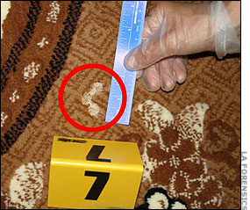
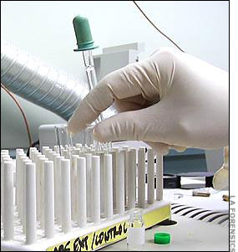
Evidence Examples: Body Fluids
Blood, semen, saliva, sweat, and urine can be analyzed to give investigators information about the crime as well as its victim or the suspect.
Chemicals and ultra violet light can be used at a crime scene to find body fluid evidence. Areas with potential evidence are swabbed, bagged and collected in vials, which are air tight and have a low risk of cross contamination.

Slide 32
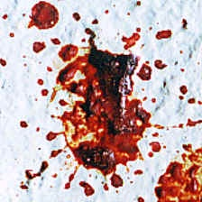
Evidence Examples: Body Fluids
Examples:
Vomit and urine can be used to test for alcohol, drugs, and poisons.
Cigarette butts may contain dried saliva.
Semen containing sperm is valuable for DNA analysis.
Blood can provide DNA evidence and blood spatter can provide clues about the crime.

Slide 33
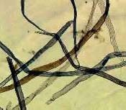
Evidence Examples: Hair & Fibers
Hairs and fibers may be transferred from the suspect or the suspect’s clothes to the victims’ and vice versa. For example, a suspect may pick up carpet fibers on his shoes or leave hairs behind at a crime scene.
Microscopic Image of Hairs & Fibers

Slide 34
Evidence Examples: Hair & Fibers
Hairs can be examined to identify their origin, such as human or animal. Hairs with roots intact can be tested for DNA.
Fibers are used to make clothing, carpeting, furniture, beds, and blankets. They may be natural fibers from plants or animals or synthetic fibers that are man-made.
Microscopic Image of Hairs & Fibers

