Slide 1
Aim: What are the pros & cons of testimonial evidence
Scanlon/Mammolito

Slide 2
What is testimonial evidence?
Testimonial evidence includes oral or written statements given to police as well as testimony in court by people who witnessed an event.

Slide 3
What is testimonial evidence?
Eyewitness accounts can be a useful tool in helping investigators with analyzing a crime scene, but are not viewed to be highly reliable. In addition, eyewitness identifications (right or wrong) can have a big influence on the outcome of an investigation or trial.

Slide 4
What is testimonial evidence?
People are likely to view the same scene in different ways depending on their positions, line of sight, familiarity with the area, and other factors that can interfere with a person’s ability to remember details.

Slide 5
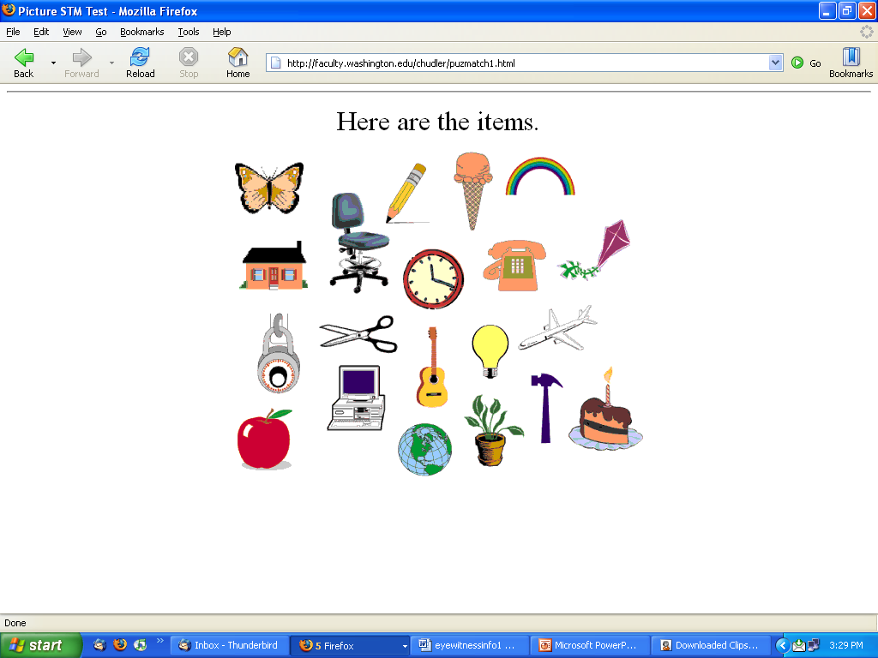
Memory Challenge
Directions:
You will have 30 seconds to view the next screen.
Try to memorize all 20 items you see!
You are NOT allowed to write anything down
You CANNOT talk to anyone else

Slide 6
Items to remember…

Slide 7
What did you remember?
You have 2 minutes to list as many of the items as you can!

Slide 8
What did you remember?
How did you do?
All 20 – Awesome
15-19 – Great
10-14 – Pretty swell
5-9 – Could be better
4 or Less – Wake up

Slide 9
The Innocence Project (2008)
According to The Innocence Project (2008) "Eyewitness misidentification is the single greatest cause of wrongful convictions nationwide, playing a role in more than 75% of convictions overturned through DNA testing." Still, the criminal justice system profoundly relies on eyewitness identification and testimony for investigating and prosecuting crimes.

Slide 10
Witness Factors
AGE
Studies have shown that when a lineup contains the actual culprit, both young children and elderly perform well, but when the lineup does not contain the culprit there is a higher rate of mistaken identifications.

Slide 11
Witness Factors
RACE
The race of the witness may also play a role. The Cross Race Effect (CRE) is a phenomenon in which people are better at recognizing faces of their own race rather than those of other races.

Slide 12
Witness Factors
DRUG USE
The use of drugs can alter a person’s ability to recall the events of a crime even after they are no longer under the influence.

Slide 13
Witness Factors
OTHER PEOPLE
A person’s memory of an event can be influenced by other witnesses, investigators, and/or the media. Investigators use open-ended questioning and follow procedures for conducting line-ups to limit their influence on a witness’ memory of an event or identification of a suspect.

Slide 14
Crime Scene Challenge
Now that your eyes and brain are warmed up, let’s test your observation skills a bit more.
You will have 2 minutes to study the photograph of a crime scene on the next slide.
Try to pay attention to details as you will be asked 10 questions about the crime scene!
You are not allowed to write anything down until after the time is up.
Ready?

Slide 15
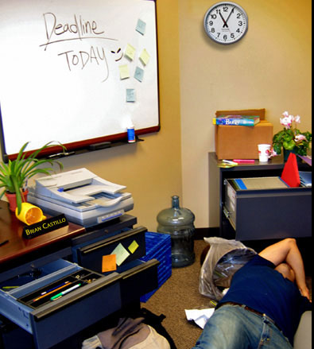

Slide 16
What do you remember?
1. What color coffee mug was in the picture? Blue Red Yellow
2. When was the deadline? Yesterday Today Tomorrow
3. What time was on the clock on the wall? 10:40 11:05 1:55
4. How many sticky notes were on the whiteboard? Four Six Eight
5. Which of the following was NOT in the picture? Stapler Trash Can Printer
6. What was the name on the plaque on the desk? Bill Brian Carl
7. What color was the victim's shirt? Black Blue Red
8. How many plants were in the picture? None One Two
9. What was the color of the marker in the desk drawer? Red Blue Green
10. Where was the book in the picture? On a box In the trash can Under the body

Slide 17
What do you Think happened?

Slide 18
YOYo
Write the answer to the following question in your notebook: We have spent time talking about the importance of eyewitness in the court room but also that they are not always accurate. Using what we have learned so far, describe the ideal witness.

Slide 19
Aim:
Pros and Cons of Testimonial Evidence
History of Forensic Science
Scanlon/Mammolito

Slide 20
Crime Scene and Suspect Factors
Trauma
A witness confronted with a weapon tends to focus on the weapon rather than the perpetrator’s face.

Slide 21
Crime Scene and Suspect Factors
Time
Someone who is able to focus on a perpetrator's face for a minute or longer will tend to have a more accurate memory than someone who saw the person for only a few seconds.

Slide 22
Crime Scene and Suspect Factors
Physical Appearance
Faces that are either highly attractive, highly unattractive, or distinctive are more likely to be accurately recognized.
Simple disguises, such as hats or sunglasses, can interfere with accurate eyewitness identification.
Body piercings and tattoos increases the likelihood of an accurate identification.

Slide 23
What did you remember?
Time of Day/Location
The time of day in which the crime occurred as well as a person’s view of the scene may affect what a he/she is able to see.
A person who is familiar with the area in which the crime took place, may have a better recall of the positions of the victims or suspects.

Slide 24
Facial Composites
Investigators work with sketch artists and eyewitnesses to create facial composites, or sketches of a person’s face. Today many police departments are using facial reconstruction software to help them with this task.

Slide 25
Facial Composites
The composite may be used internally to assist officers in identifying the suspect or used externally through local media (radio, TV, and newspaper) to solicit leads from citizens.

Slide 26
Facial Composites
FACES – A software program that offers many options to help you recreate a person’s facial features

Slide 27
History of Forensic Science
In groups of 2 or 3, use the text provided to create a timeline showing major developments in forensic science.
You must include a minimum of 10 events.
If you find unfamiliar words in the reading, write them on the back of the timeline and we can review them later
TRY NOT TO WRITE ON THE TEXT ITSELF

Slide 28
Before you Leave – Exit Ticket
On the piece of paper provided, respond to the following prompt. We have come along way in developments in forensic science. What do you think forensic science would look like in 10 years? 25 years?

Slide 29
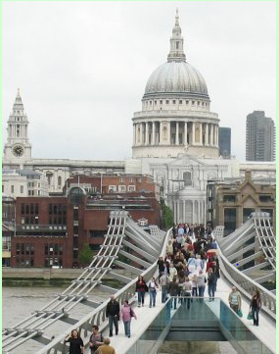
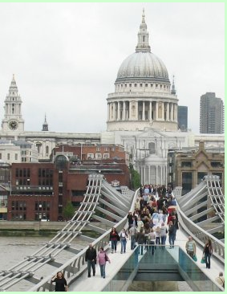
YOYO – Spot the differences

Slide 30
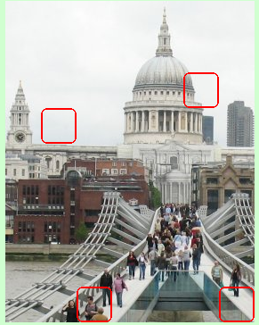

YOYO – Spot the differences

Slide 31
Aim:
History of Forensic Science
Scanlon/Mammolito

Slide 32
History of Forensic Science
In groups of 2 or 3, use the text provided to create a timeline showing major developments in forensic science.
You must include a minimum of 10 events.
If you find unfamiliar words in the reading, write them on the back of the timeline and we can review them later
TRY NOT TO WRITE ON THE TEXT ITSELF

Slide 33
What did you add to your Timeline? Why?

Slide 34
Sketch drawing video
https://www.youtube.com/watch?v=h81SuD2pltM

