Slide 1
YOYO
One rainy evening, Mr. Body killed 5 people at Clue Mansion. The people killed were Mrs. White, Mr. Green, Professor Plum, Colonel Mustard, and Ms. Scarlet. The murders took place in the kitchen, billiards room, conservatory, hall, and library. No two people were murdered with the same weapon. The weapons were candlestick, rope, revolver, knife, and lead pipe. From the clues given, try to determine the room in which each person was killed and the weapon used.
The murder with the lead pipe was not done in the hall or the library.
Mr. Green was not murdered in the kitchen.
The rope was not the murder weapon used in the library.
Neither Mrs. White nor Ms. Scarlet were murdered with the candlestick, the revolver, or the lead pipe.
The person who was murdered in the billiards room had just finished having dinner with Ms. Scarlet, Mr. Green, the person done in with the candlestick, and the victim of the rope.
Neither Mr. Green nor Professor Plum were killed with the lead pipe, in the hall, or in the library.

Slide 2
YOYO answer
Victim | Weapon | Location
Mrs. White | The rope | The hall
Mr. Green | The revolver | The conservatory
Professor Plum | The candlestick | The kitchen
Colonel Mustard | The lead pipe | The billiards room
Ms. Scarlet | The knife | The library

Slide 3
Aim: Challenge #1 & The Importance of Observations
Forensics – Scanlon/mammolito

Slide 4
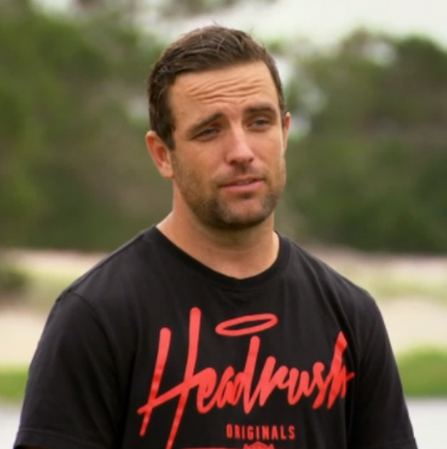
Welcome you your first challenge!
The Task:
In groups of 4/5, build the tallest tower of Styrofoam cups in 5 minutes (you will have 1 minute to brainstorm as a team)
The Catch:
You can only use the supplies given (6 cups, 5 pieces of string, 1 rubber band)
You can only use one hand, and it CANNOT touch the cup

Slide 5
Cup Stacking Challenge Discussion

Slide 6
Whodunnit Video
https://www.youtube.com/watch?v=8-hapS2SPz4

Slide 7
Brain Games witness Video
https://www.youtube.com/watch?v=RWO2UQ4MW7U

Slide 8
YOYO
One rainy evening, Mr. Body killed 5 people at Clue Mansion. The people killed were Mrs. White, Mr. Green, Professor Plum, Colonel Mustard, and Ms. Scarlet. The murders took place in the kitchen, billiards room, conservatory, hall, and library. No two people were murdered with the same weapon. The weapons were candlestick, rope, revolver, knife, and lead pipe. From the clues given, try to determine the room in which each person was killed and the weapon used.
The murder with the lead pipe was not done in the hall or the library.
Mr. Green was not murdered in the kitchen.
The rope was not the murder weapon used in the library.
Neither Mrs. White nor Ms. Scarlet were murdered with the candlestick, the revolver, or the lead pipe.
The person who was murdered in the billiards room had just finished having dinner with Ms. Scarlet, Mr. Green, the person done in with the candlestick, and the victim of the rope.
Neither Mr. Green nor Professor Plum were killed with the lead pipe, in the hall, or in the library.

Slide 9
Aim: The Importance of Observations & Fact vs. Opinion
Forensics – Scanlon/mammolito

Slide 10
The Importance of Observations
One of the most importance tools of the forensic investigator is the ability to observe, interpret, and report observations
Observation: what a person perceived using his or her senses
Perception: interpreting info received from the senses, though it can be faulty and our brain will fill in missing information.
Eyewitness: a person who has seen someone or something and can communicate these facts
Logical: conclusions drawn from assumptions and known facts

Slide 11
What does this say?
RJQLQCX LS EUN

Slide 12
Can you…say the COLOR of the word and NOT the word itself?
ORANGE
BLACK
BLUE
YELLOW
RED
GREEN
BROWN
BLUE
PURPLE
GREEN
BLACK
BROWN
YELLOW
RED
PURPLE
Stroop Test

Slide 13
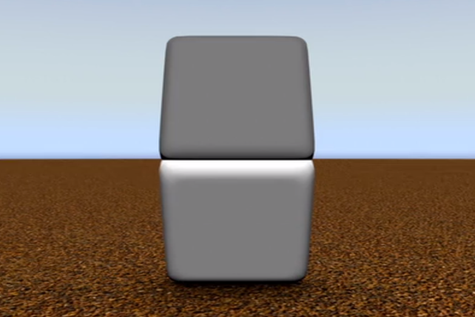
Are the 2 squares the same color?

Slide 14
YES!!!

Slide 16
Fact vs. Opinion Activity

Slide 17
YOYO answer
Victim | Weapon | Location
Mrs. White | The rope | The hall
Mr. Green | The revolver | The conservatory
Professor Plum | The candlestick | The kitchen
Colonel Mustard | The lead pipe | The billiards room
Ms. Scarlet | The knife | The library

